Slide 1
Особенности урока MYP в программе IB

Slide 2
Знание – не самоцель,
а средство самоопределения человека в мире,
способ погружения ученика в культуру,
осознание им себя в культурном пространстве.

Slide 3
Требования к уроку
Четкая постановка образовательной цели урока
Лаконичность её формулировки
Реалистичность и достижимость цели
Научность, сложность и доступность содержания урока
Практическая направленность
Актуальность, Проблемность, привлекательность учебной информации
Понимание учащимися структуры урока

Slide 4
Assessment Criteria
Criterion A Oral communication Maximum 8
Criterion B Visual Interpretation Maximum 8
Criterion C Reading comprehension Maximum 8
Criterion D Writing Maximum 8

Slide 5
Введение темы с помощью unit question
What can be called the wonder of the world and why?
What are the best ways of earning and spending money?
Why do you think good education is important and how can you become successful in learning?
What do eating habits tell about us?

Slide 6
Как сформулировать проблему?
I bought a new car yesterday.
I have bought a new car. (I feel really happy about it.)

Slide 7
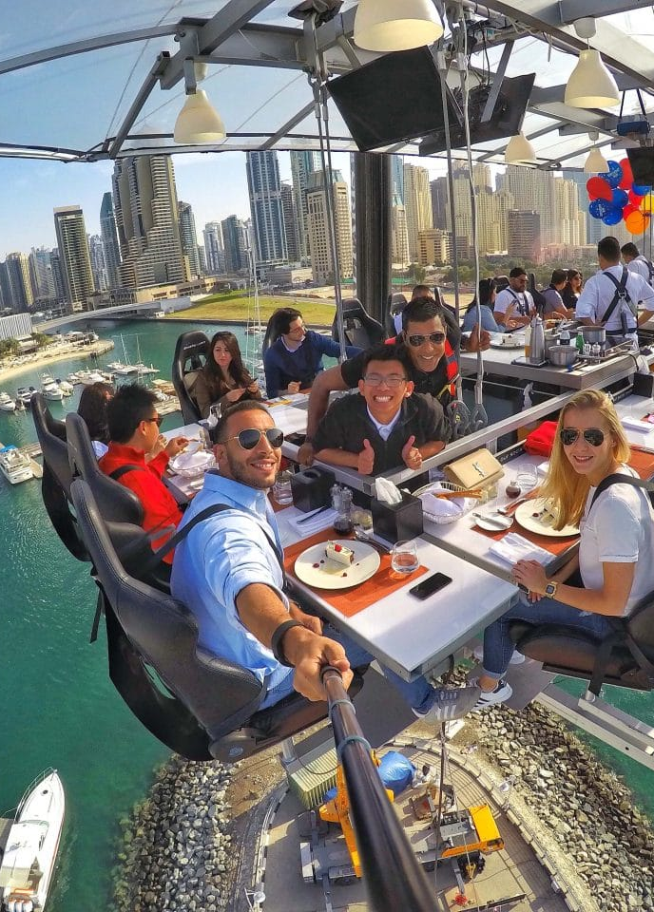
How to start reading comprehension?
Text “Out of the Ordinary” (level Elementary, grade 5)

Slide 8
Reading Comprehension “Out of the Ordinary” Unit 4
1.Read the text. What do some restaurants do to attract customers? (3-4)
________________________________________________________________________________________
2.Match the names of the restaurants to the photos (5-6)
1 ___________ 2 __________ 3 ___________ 4 ____________
3.In how many countries can you experience Dinner in the Sky? (1-2)
____________________________________________________________________________________
5.In which restaurant(s) do they have other furniture instead of chairs? (3-4)
_____________________________________________________________________________________
6.In which restaurant is it dangerous to leave the table? Why? (3-4)
________________________________________________________________________________________
7.What does the waiter in an old DC-10 aeroplane use? (1-2)
_____________________________________________________________________________________
8.How often do you eat out? What kind of food do you like to eat when you eat out? (7-8)
________________________________________________________________________________________
9.Which of the restaurant from the text would you like to visit? Why? (7-8)
_______________________________________________________________________________________________________________________________________________________________________________________________________________________________________________________________

Slide 9
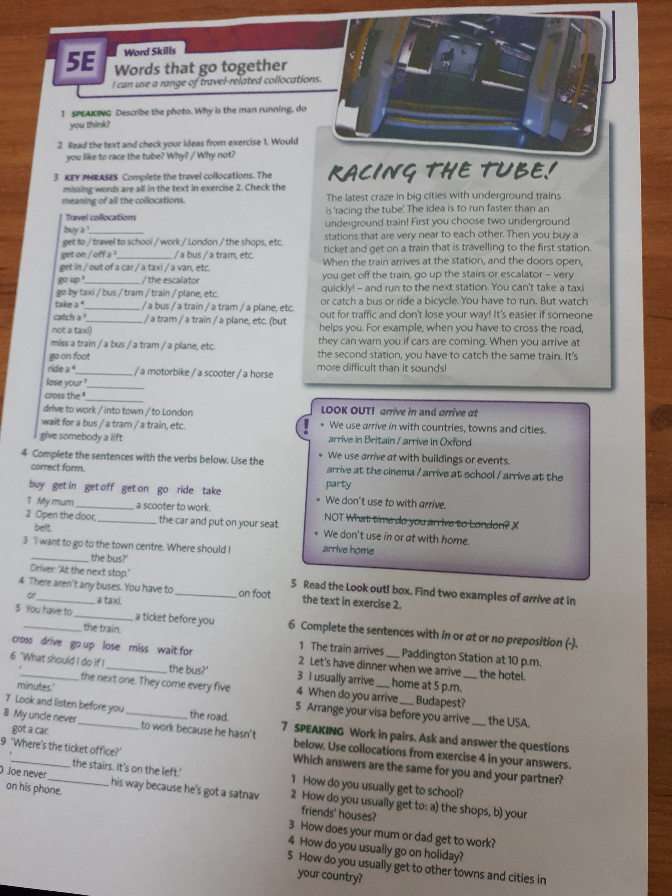
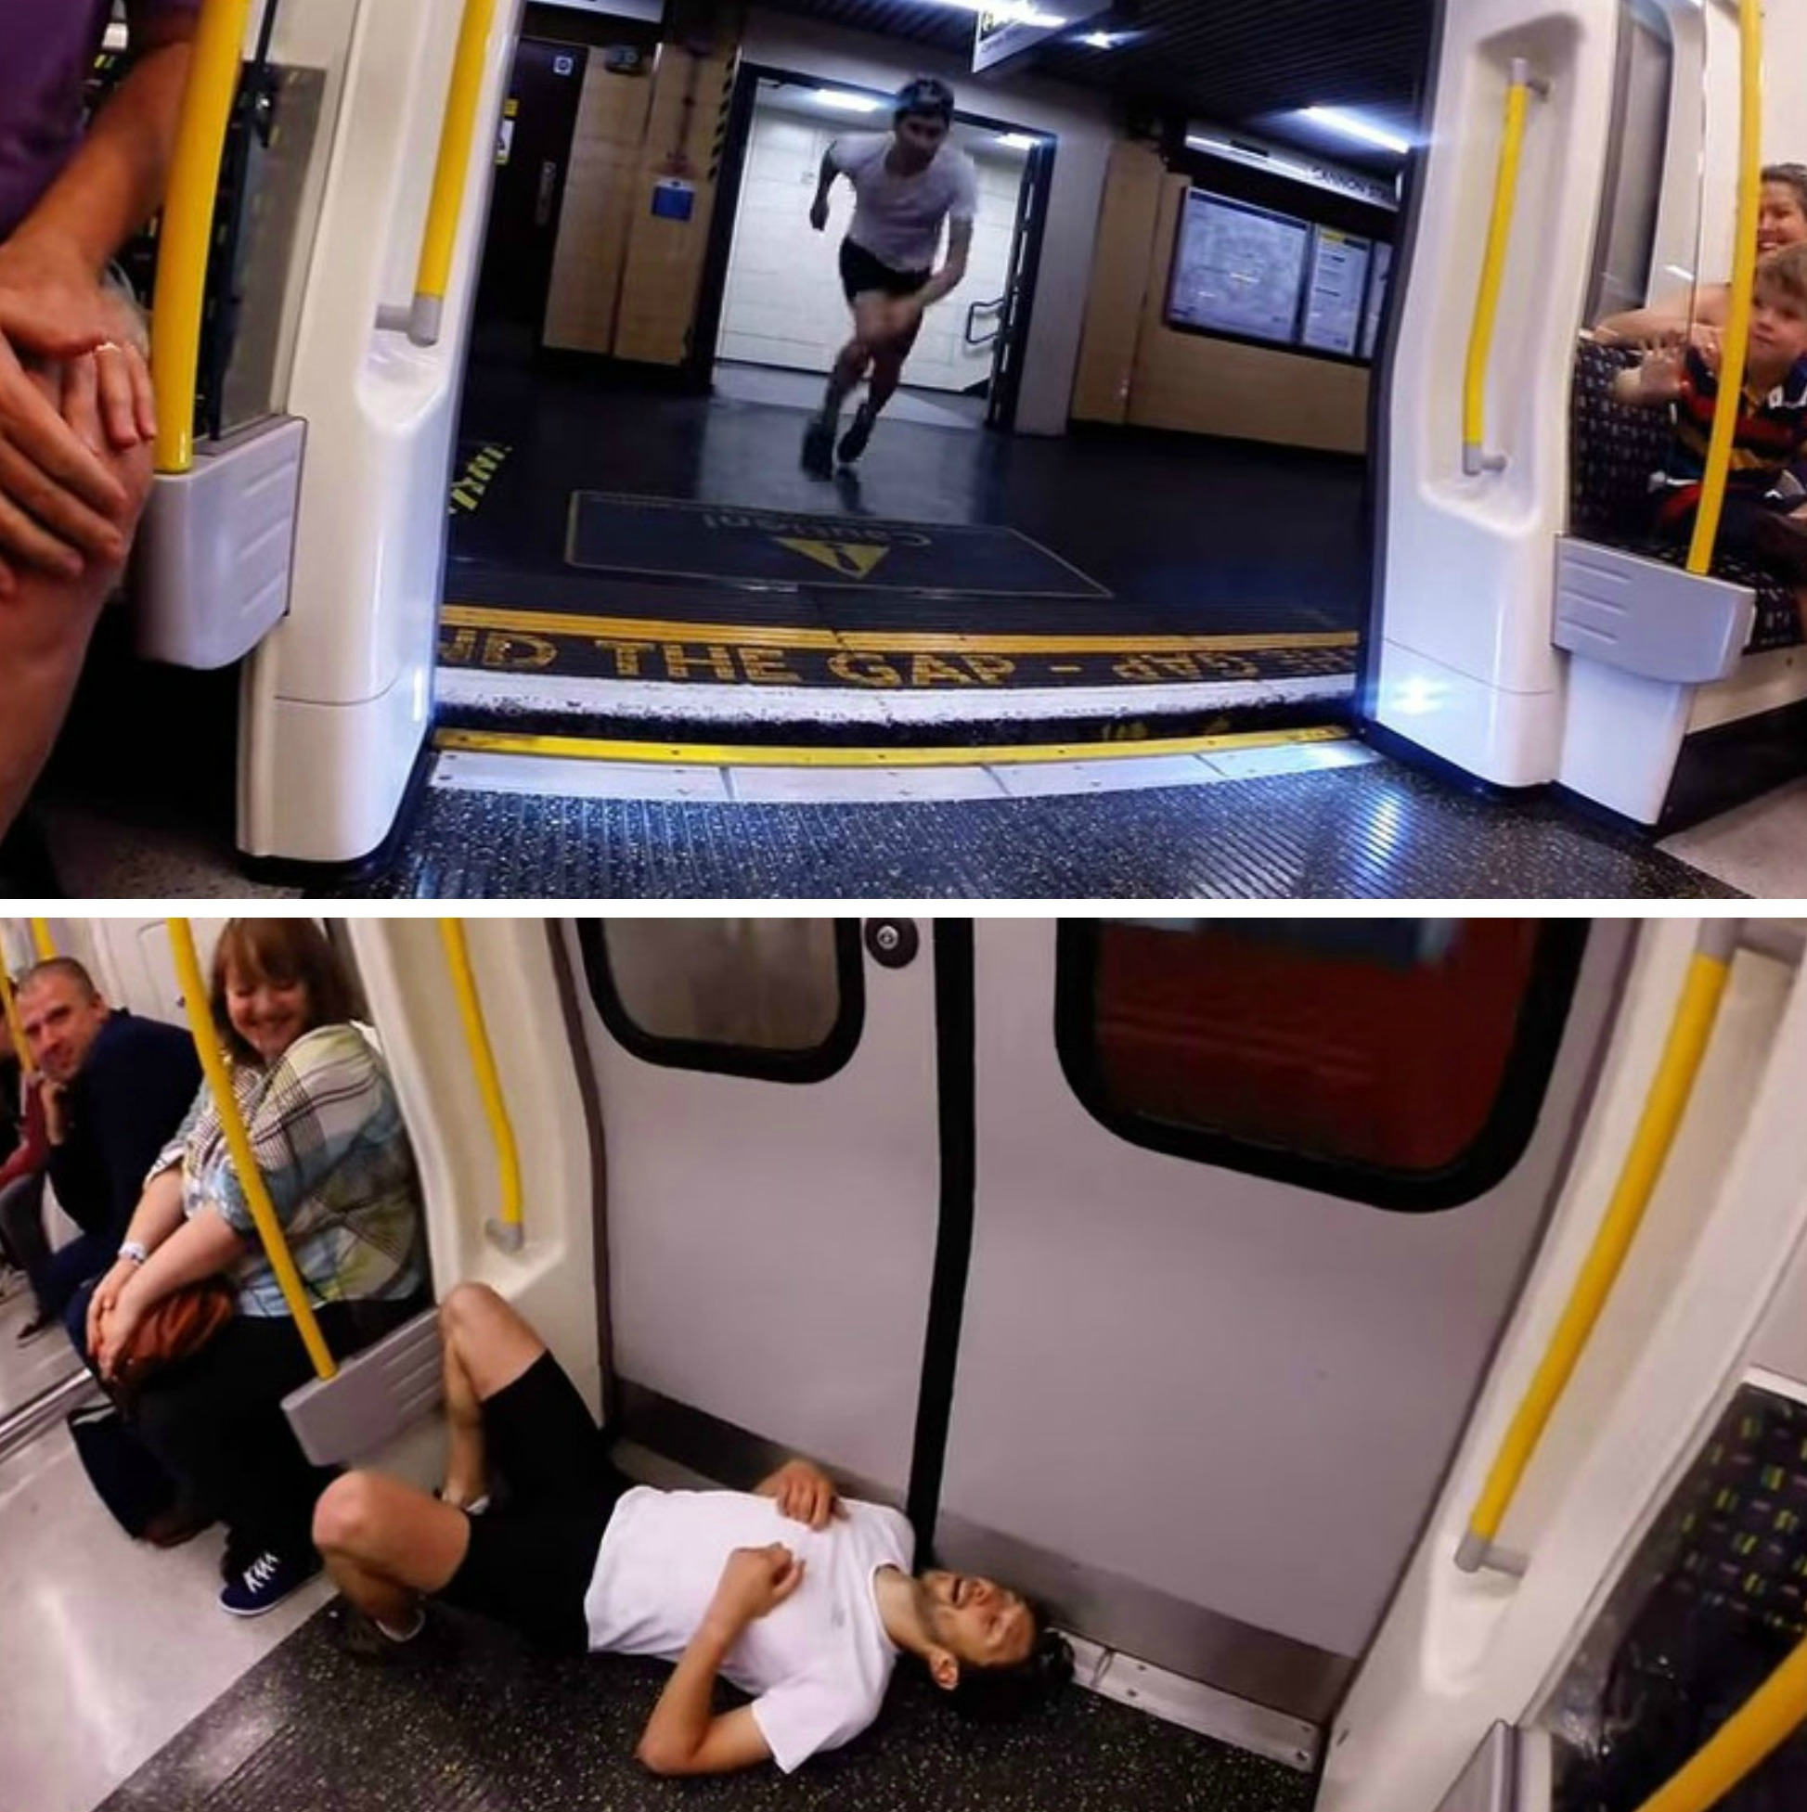
Использование visual interpretation при работе с лексикой

Slide 10
Оптимальное соотношение форм учебной деятельности:
- коллективной
- групповой
- индивидуальной

Slide 11
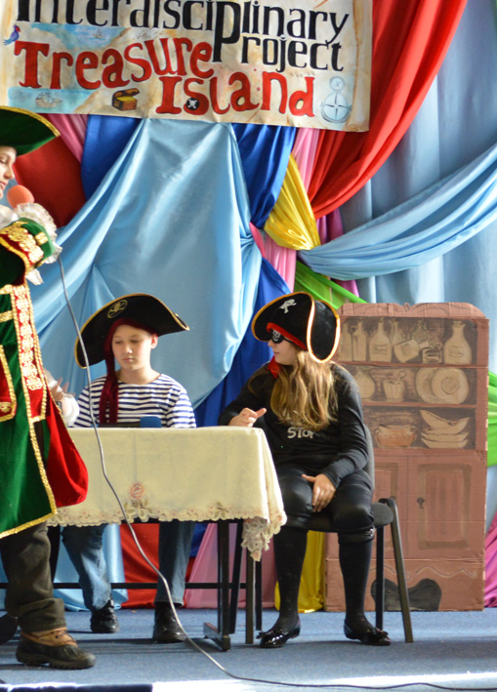
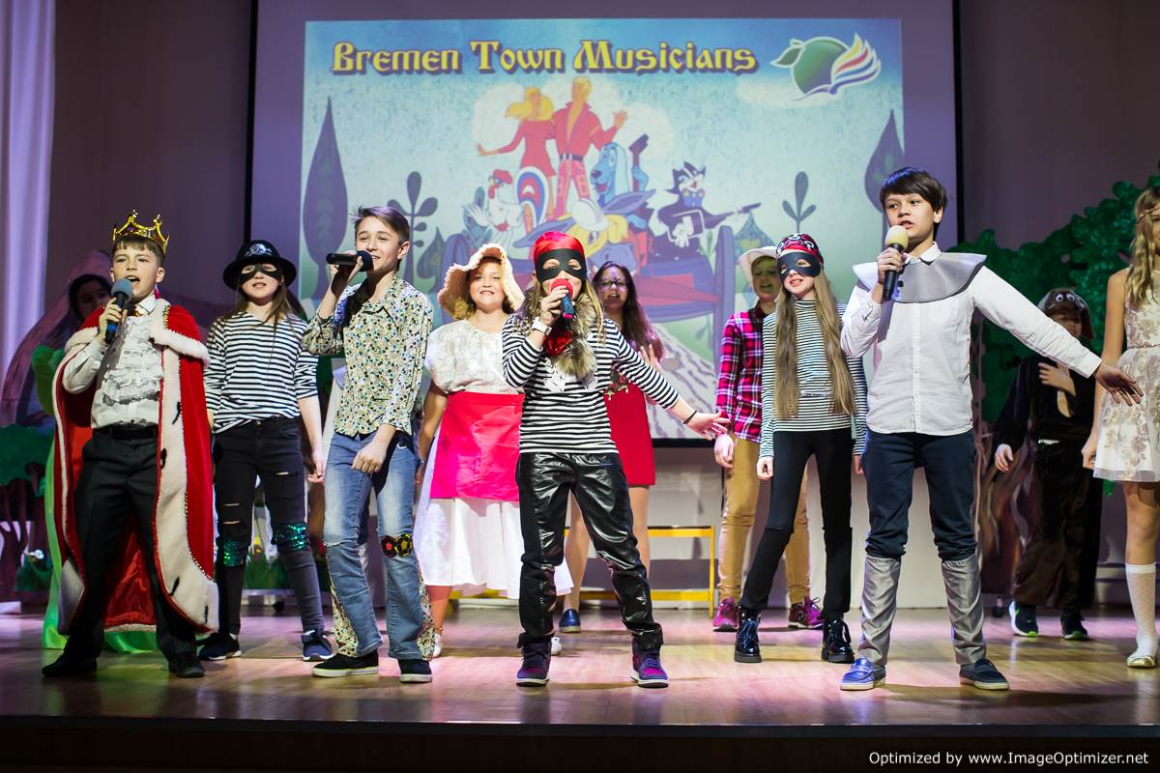
Проектная деятельность:
Drama

Slide 12
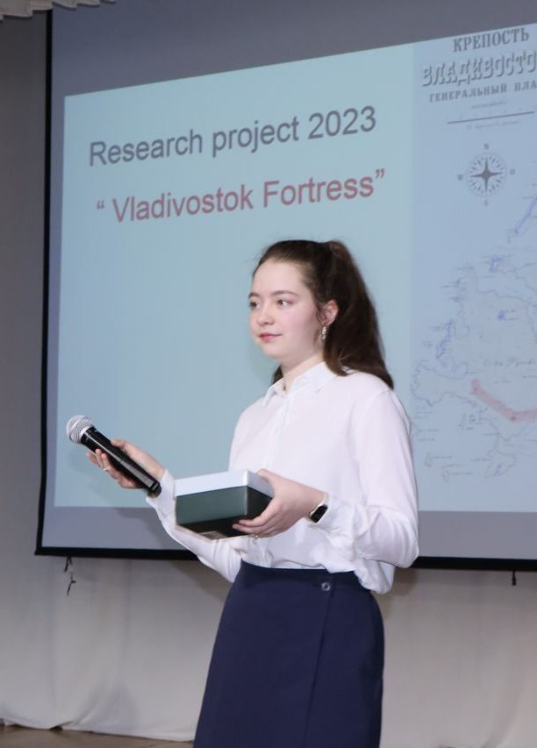
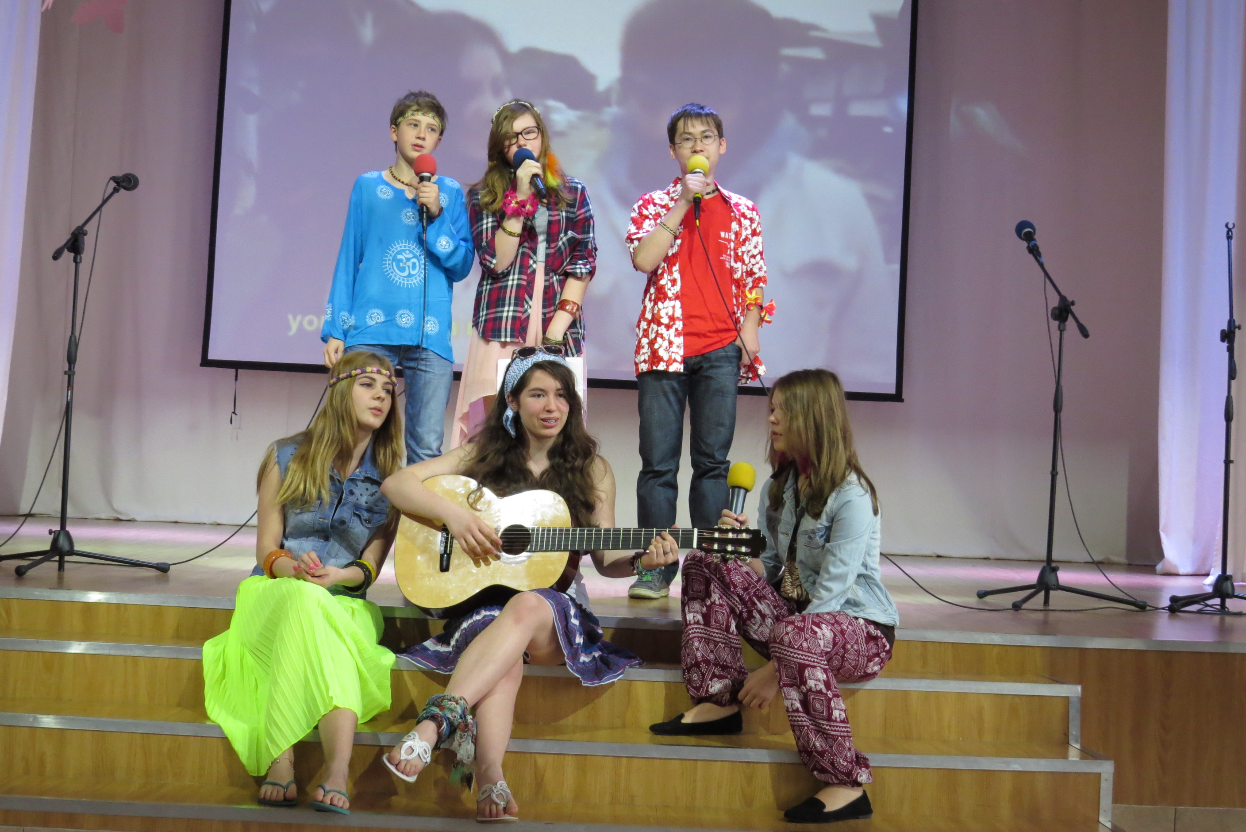
Research projects

Slide 13

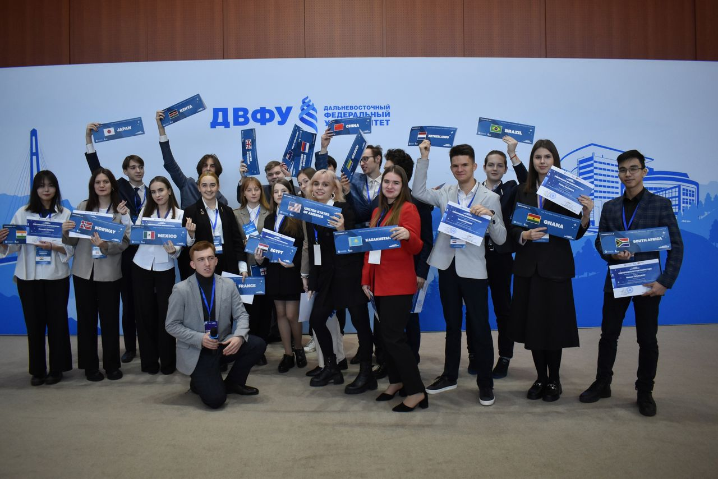
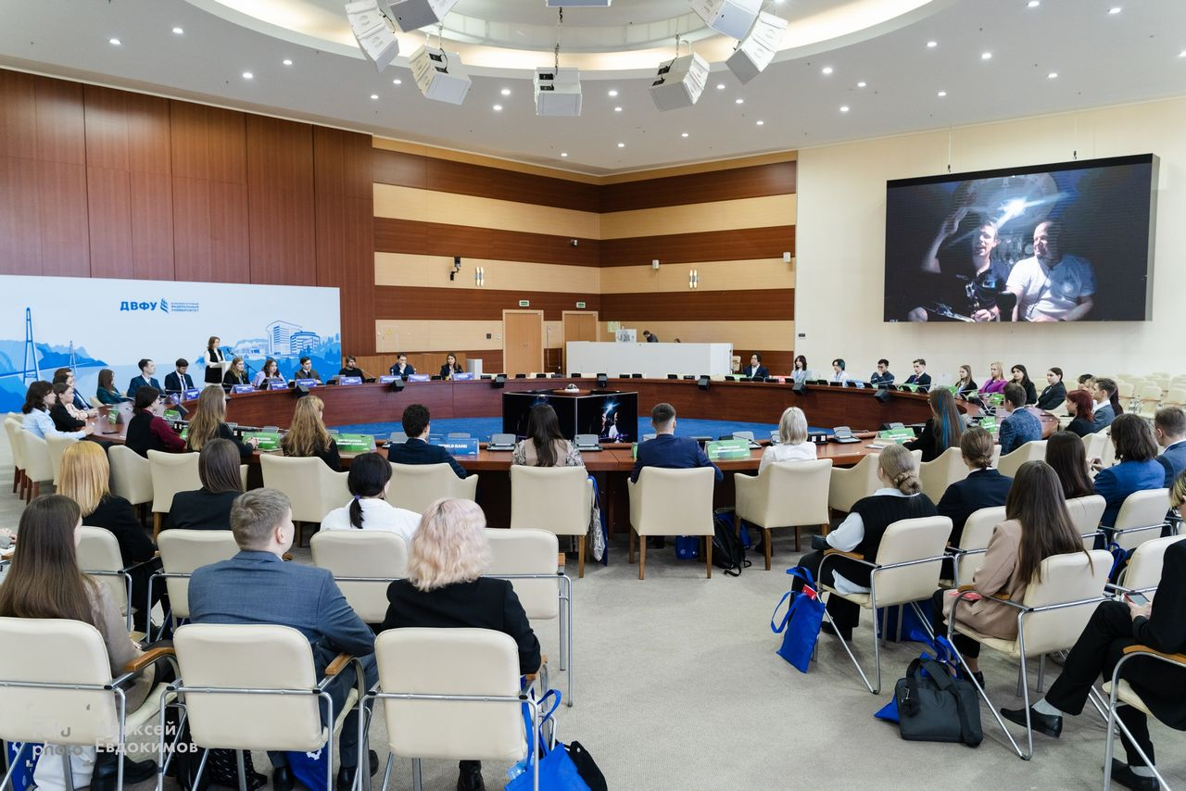
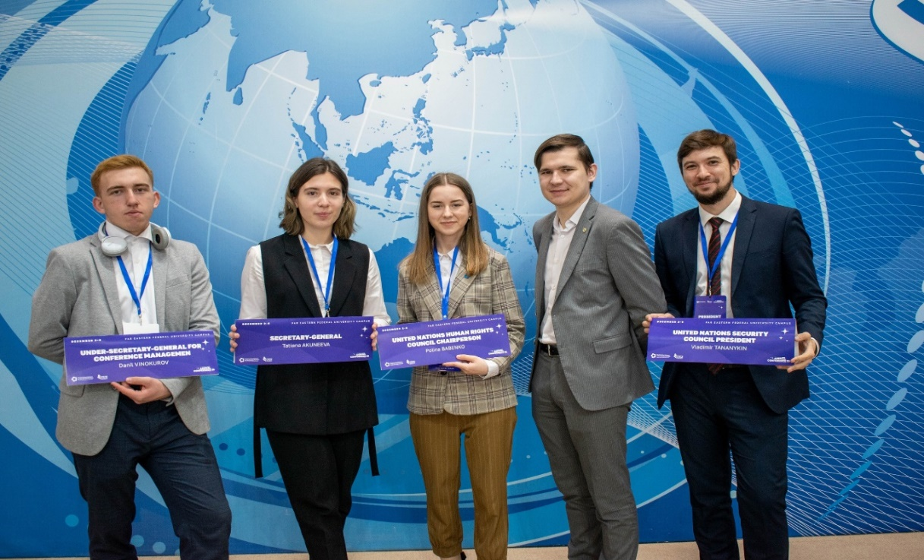
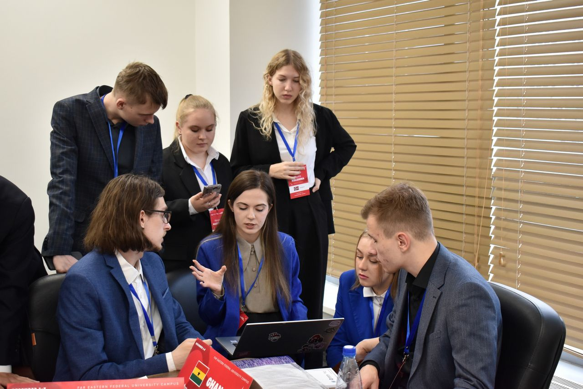
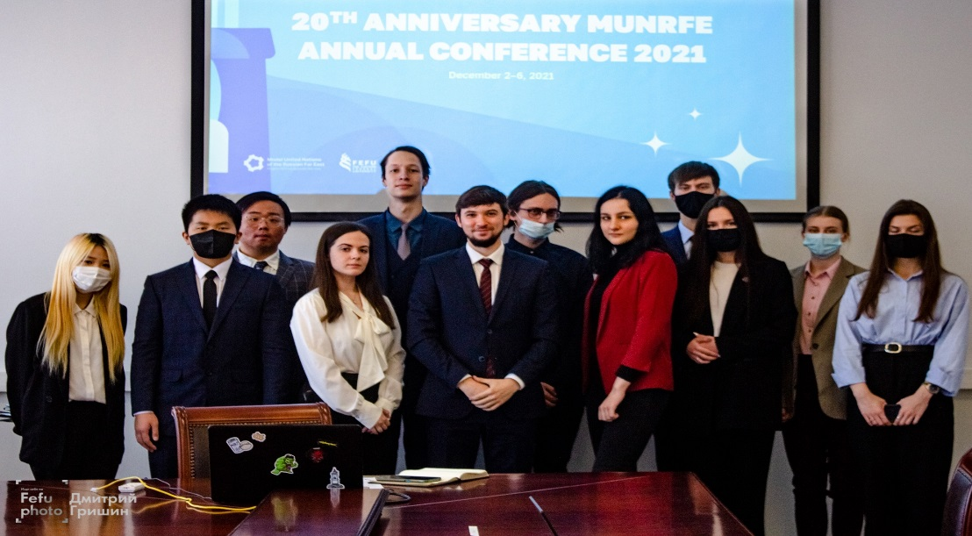


Debates

Slide 14
I can…
*= I need more practice
**= I sometimes find this difficult
***= No problem!
 | * | ** | ***
I can describe how people are feeling.
I can use the past simple affirmative, negative and interrogative.
I can listen for gist.
I can use the past simple to describe events.
I can understand a text about an unusual medical condition.
I can relate and react to past events.
I can write a description of an event.

